Slide 1
Brown Lab Bioinformatics Introduction
Ultra conserved elements
Bioinformatic overview
Lab computers and linux

Slide 2
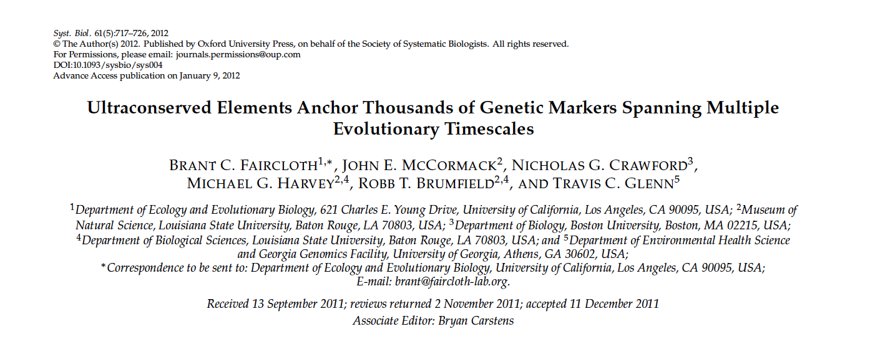
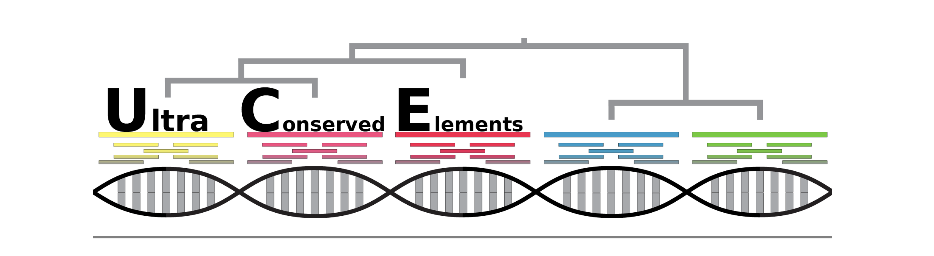
Ultraconserved elements (UCEs)
~2000 loci across all chromosomes, ~ 3,000,000 bp of sequence data
Notes:
One of the most popular phylogenomic methods in the past decade comes from this paper by Brant Faircloth from LSU, who described the use of these “ultraconserved elements” in phylogenomic studies. UCEs are short regions of the genome that share 100% identity across a given set of taxa. There are thousands of them in the genome, and if you sequence a bunch of them for your taxon sample, you can basically randomly sample your genome since they’re scattered everywhere.
The way a UCE is structured is around an invariable “core” region with very low differentiation across taxa. The flanking regions increase in divergence; these are what you actually use to construct the phylogeny.
Since 2012, the Faircloth group has made a variety of bioinformatics and genomics resources available for using UCEs in phylogenomics studies and they’ve become quite popular. This is the logo of the website ultraconserved.org. UCEs have already been used to resolve difficult questions in animal phylogeny such as the relationships of turtles to other vertebrates, the deep level relationships among birds, and the relationships of squamate groups.

Slide 3


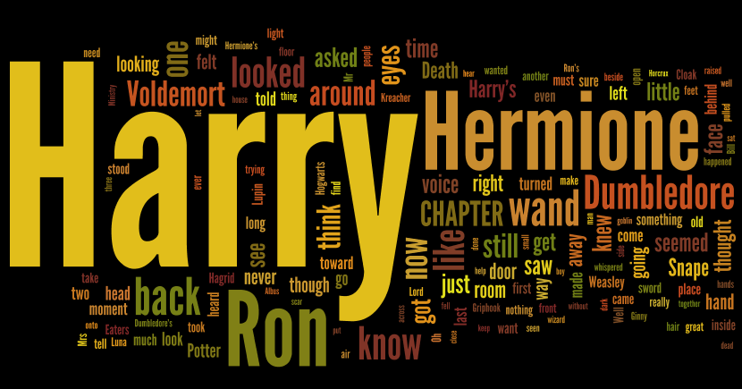

Slide 4


But, starting with 10,000 copies of the same puzzle mixed together

Slide 5
Genome
Next-Generation Sequencing (NGS)
Raw Reads
(data we start with)
Bioinformatics Pipeline
Processed and aligned reads
Final sequence for that individual

Slide 6
Genome
Next-Generation Sequencing (NGS)
Raw Reads
(data we start with)
Bioinformatics Pipeline
Processed and aligned reads
Final sequence for that individual

Slide 7
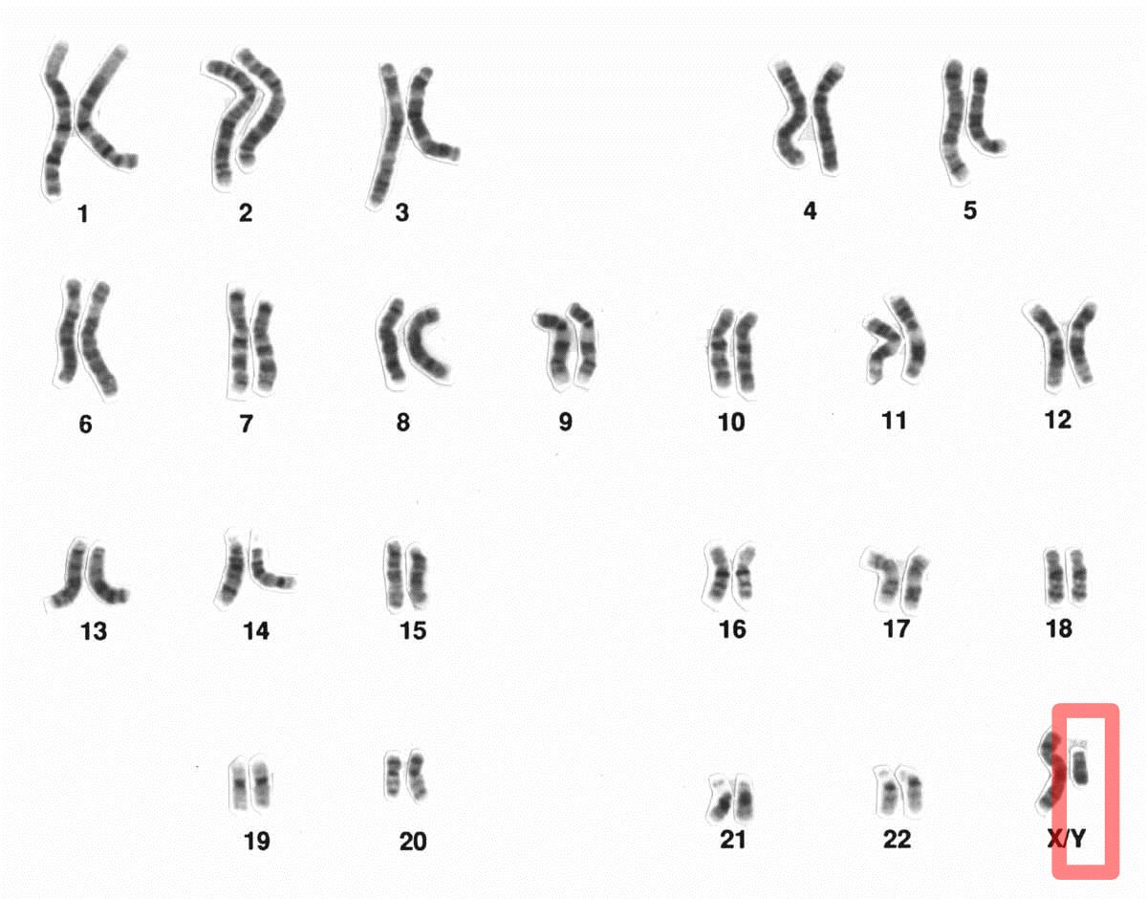
=

Slide 9
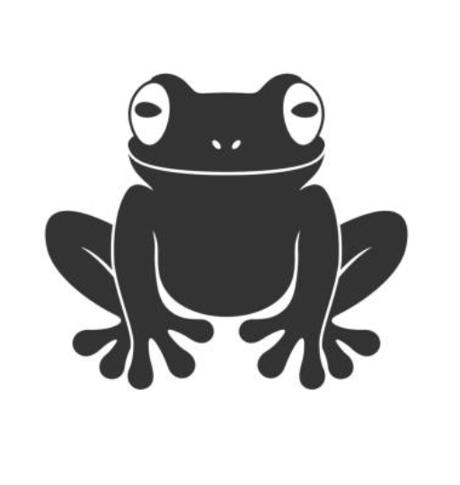

Slide 11

X 100
Repeat for every frog

Slide 12

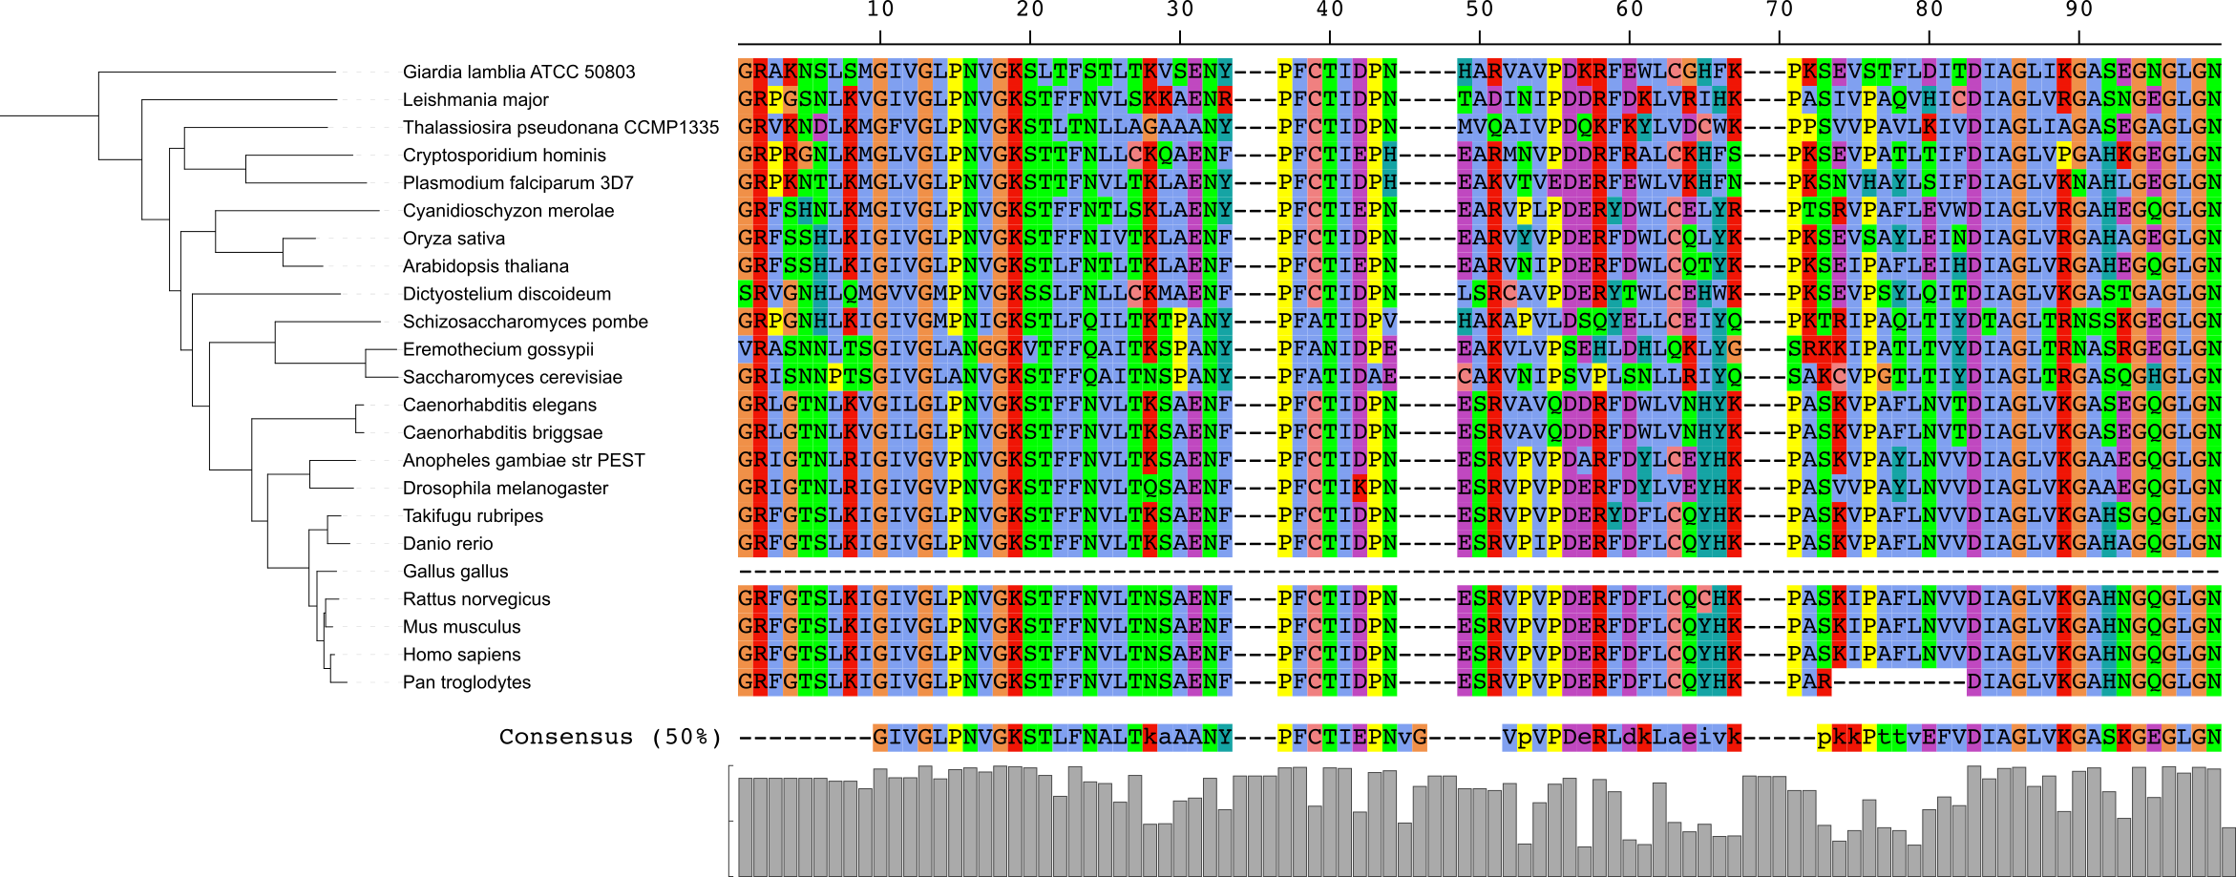
Multiple Sequences Alignment

Slide 13








Bioinformatics
Overall pipeline:
Read trimming:
Assembly:
Alignment:
Phylogenetic analysis:
Divergence time estimation:
Notes:
In case you’re interested, here’s a list of the programs I used in this project. Primarily we used Phyluce as our main pipeline, which was developed specifically to use with UCEs. It organizes your data and arranges it for you, making it easy to pump it in and out of the various downstream programs.
We used Illumiprocessor to trim reads and clean off the end tags that were attached during sequencing.
We then used Trinity to assemble the reads into contigs. Trinity takes the raw data and figures out which portions match up and correspond to a single contiguous strand of DNA. Theoretically, each contig will correspond to a UCE locus.
We then have to align the sequences, which lines them up so that each column corresponds to a homologous nucleotide for each taxon.
Then we can run the alignments through phylogenetics programs. I used two : IQ-TREE, a maximum likelihood method, and ASTRAL, a coalescent method. IQ-TREE directly takes sequence data and then spits out a single tree. ASTRAL takes a bunch of individual gene trees. By gene trees I mean a tree for a single UCE locus, itself in IQ-TREE. ASTRAL reconciles the differences between the gene trees, which accounts for differences in gene history that can lead to incomplete lineage sorting.
Finally, we performed divergence time estimation, calibrating the tree and finding how long ago each branch diverged. We used BEAST, a Bayesian method, and RelTime, implemented in MEGA, a maximum likelihood method.

Slide 14



Bender Tom Servo Wall-e

